Slide 1

ONLINE VOTING SYSTEM
PROJECT GUIDE: PRESENTED BY:
Smt.T.HYMAVATHI ULAPU ANANYA
Ass. Prof Y21CA061

Slide 2
ABSTRACT
“Online Voting System” aims at making the voting process easy in any type of elections. Presently voting is performed using ballot paper and the counting is done manually, which consumes a lot of time. There can also be a possibility of invalid votes.In Online Voting System, voting and counting is done with the help of computer and mobile phones. It saves time, avoids errors in counting and there will be no invalid votes. It makes the election process easy. It also avoids the process of physical touching or visiting any places and so in the time of pandemic too it will be more helpful to conduct elections. As the system deals with the online voting, it allows the citizen to get the details of the candidate and the voter and vote for the respective candidate without any wastage of time. In the existing manual system, ballot paper is used and the votes are counted,consumes lot of time. Hence, there is a need for Online Voting System.

Slide 3
PROBLEM STATEMENT
“Online Voting Systems” are rapidly overlapping the traditional paper-based voting in traditional voting there are number of factors that make rigging in whole electoral process such as counting of votes, fake votes and involvement of outside sources and also other problems like time consumption, cost budget problems etc. So the purpose of this proposal is to investigate how to model an authentic reliable and upright. Online Voting System so that a voter is submitting a vote in secure manner. While maintaining the time, verification, budget and also the security of entire system.

Slide 4
eXISTING SYSTEM
Existing system is a manual one in which users and the details of the candidates are stored in books. Duplication of votes are given. Counting of votes are done manually which takes alot of time. So, there is a compulsory need in physical presence in the time of vote counting.
Disadvantages:
It is difficult to maintain important information in books.
More manual hours are needed for counting of votes.
Voters have to wait in long queues for voting they have to travel long distances.

Slide 5
PROPOSED SYSTEM
The voters are allowed to vote online they can even vote by sitting at home. Every user allowed to vote only once so there is no chance of duplicate votes. They can easily use the tool that decreases manual hours spending for normal things and hence increases the performance.
Advantages:
It does not require any physical presence.
It is very easy to conduct elections even during the pandemic situations without spread of diseases.
Vote counting can be made very quickly and results will be displayed in the less time.

Slide 6
System requirements
HARDWARE REQUIREMENTS:
System : Intel core i3.
Hard Disk : 500 GB.
Monitor : 15 inches.
Mouse : Logitech.
Ram : 4 Gb.
SOFTWARE REQUIREMENTS:
Operating system : Windows 10.
Coding Language : JAVA/J2EE
Data Base : MYSQL

Slide 7
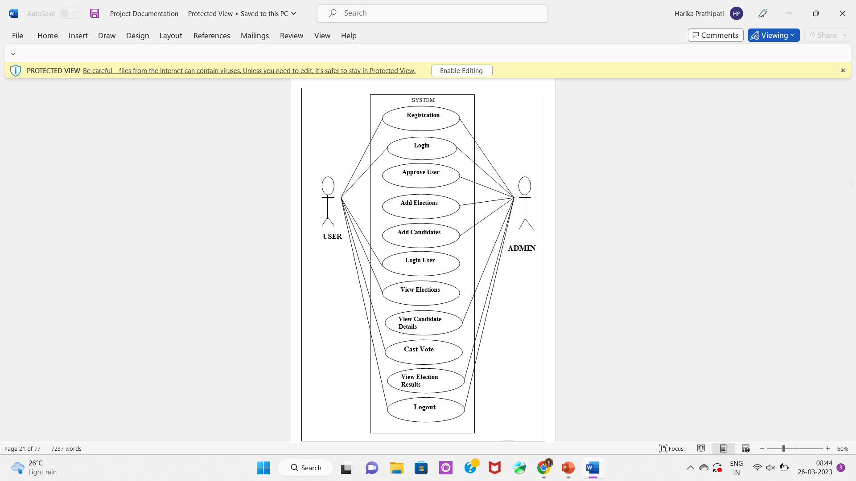
Overall USE CASE DIAGRAM

Slide 8
MODULES
1) Voter:
Voter creates a profile by registering. Voter login to the website with the Email address and password. Voter can cast the vote for the particular candidate and logouts from his/her profile.
2) Admin:
The admin will get login to the website. The admin can able to add and update candidates in admin’s profile .The admin can view the registered voters list and approve the voter to cast the vote. The admin can view the results of the candidates who won with majority of votes. The admin finally log out from the website.

Slide 9
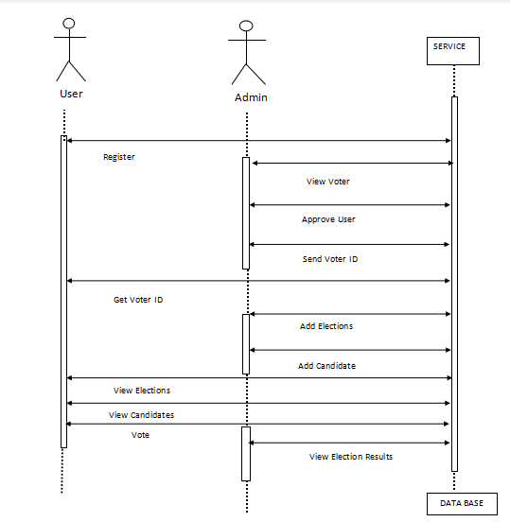
SEQUENCE DIAGRAM

Slide 10
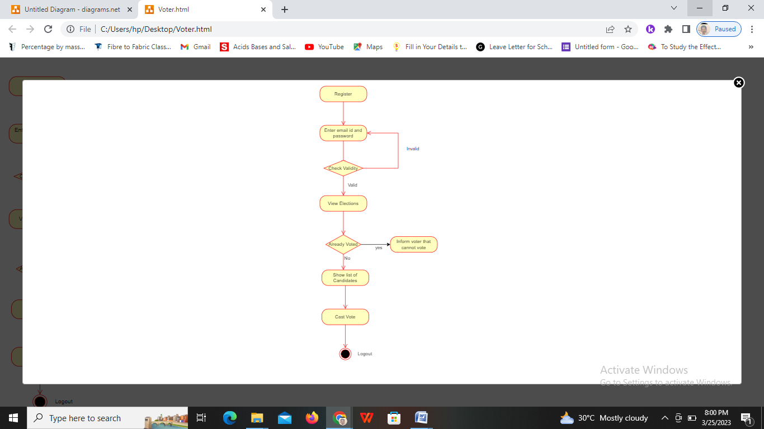
Activity diagram for Voter

Slide 11
Activity diagram for admin

Slide 12
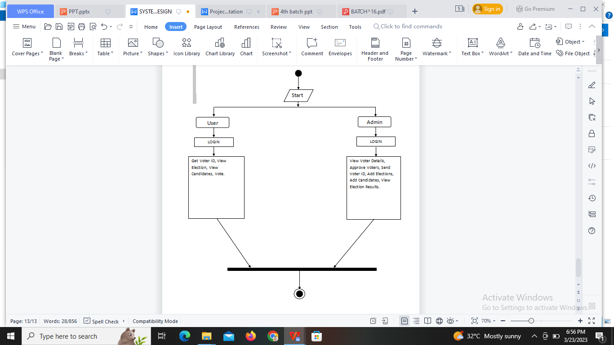
Activity diagram for online voting system

Slide 13
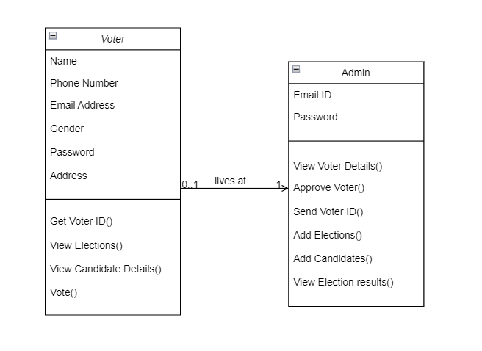
Class diagram

Slide 14
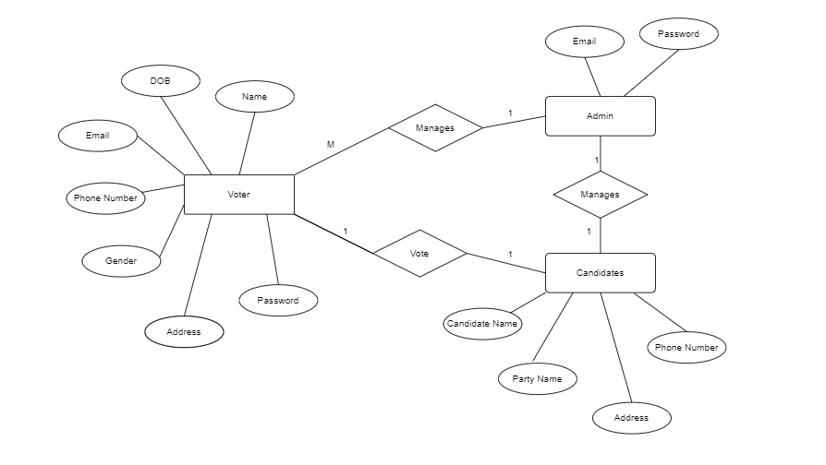
ENtity Relation diagram

Slide 15
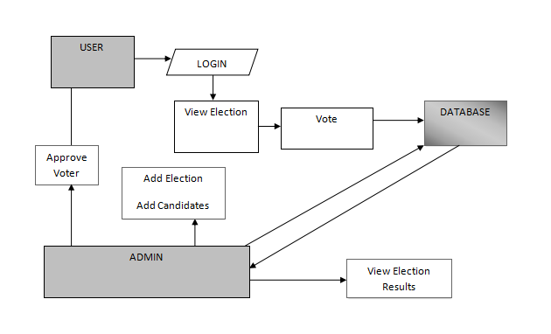
SYStem Architecture

Slide 16
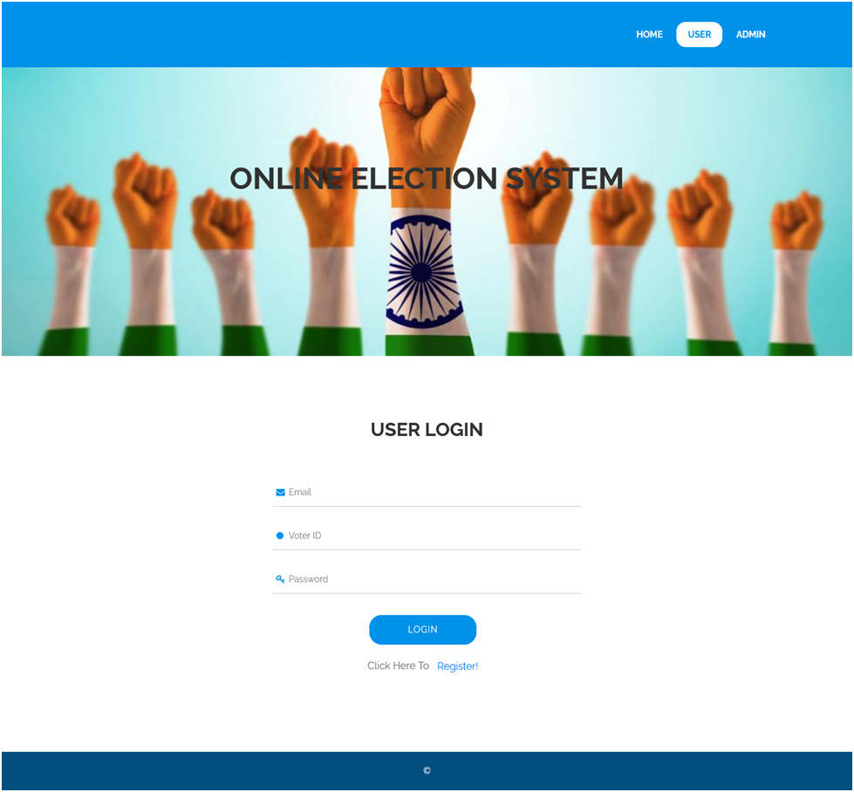
Screen shots
USER LOGIN

Slide 17
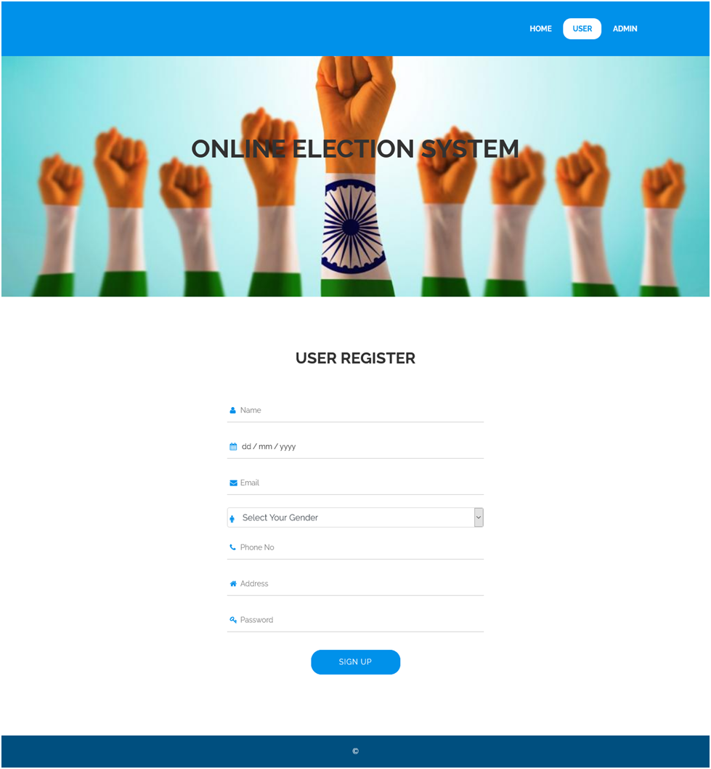
USER REGISTRATION

Slide 18
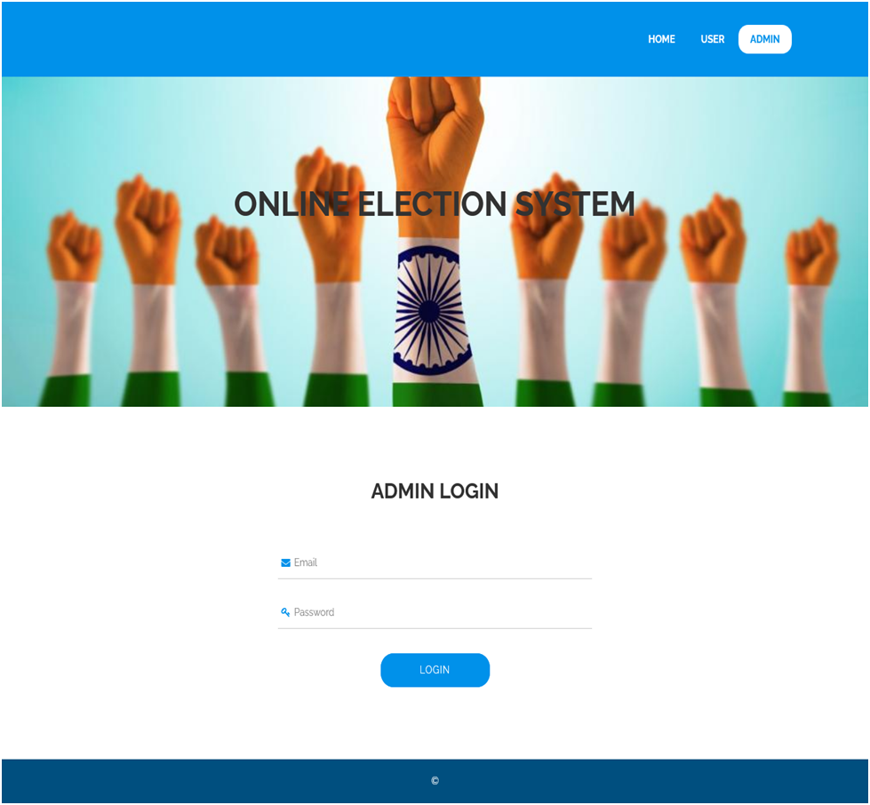
ADMIN LOGIN

Slide 19
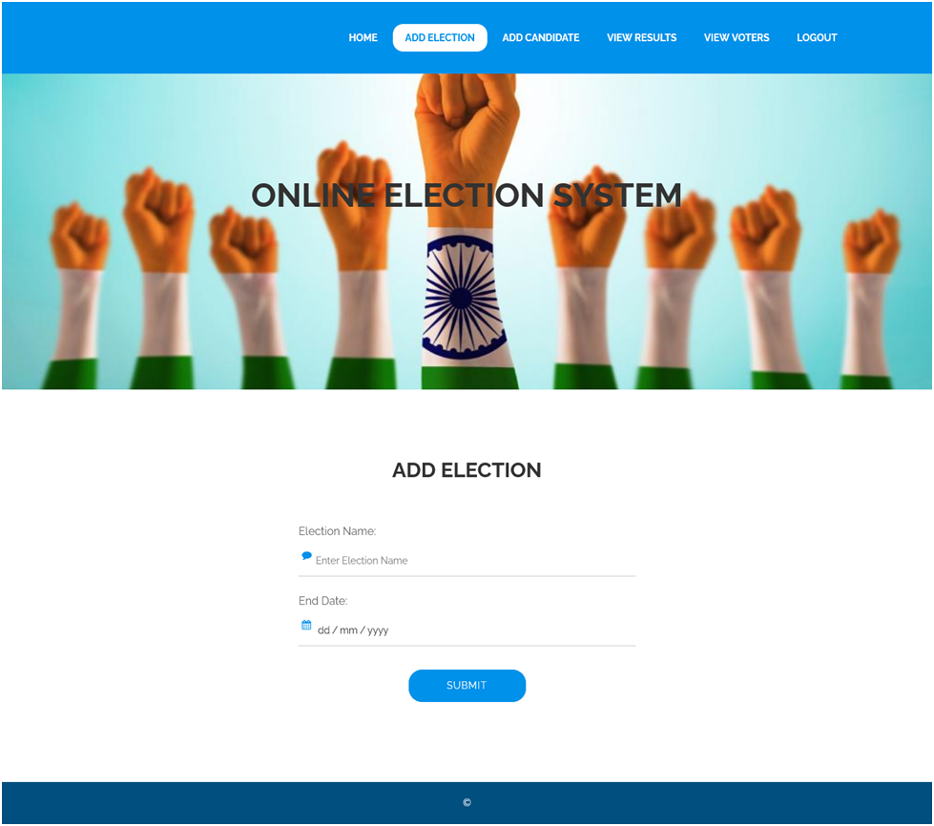
ADMIN ADD ELECTIONS

Slide 20
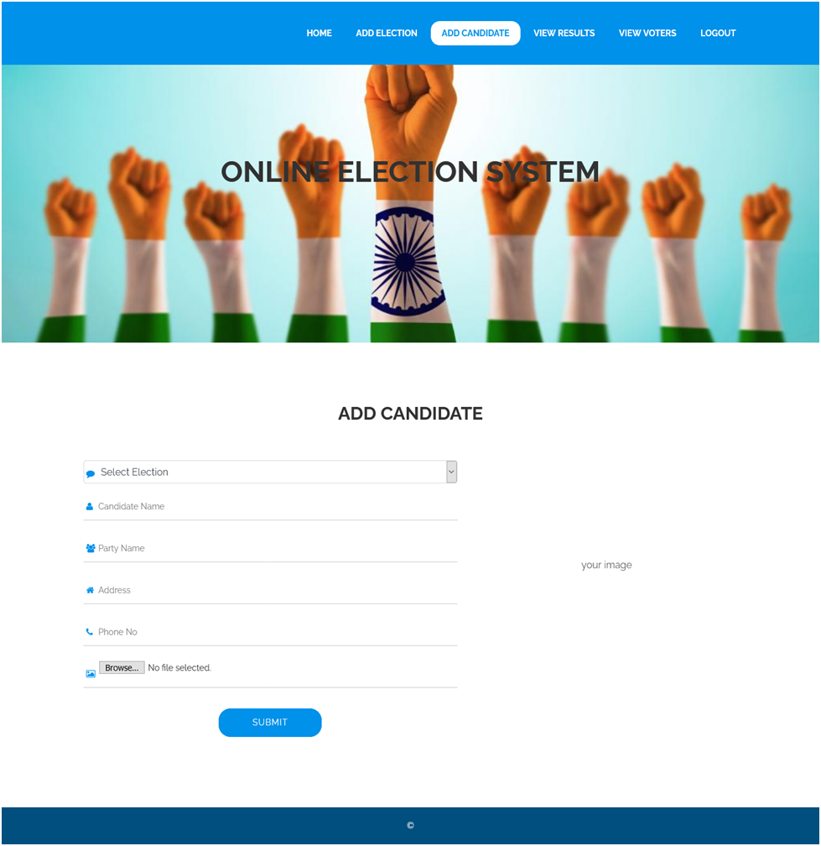
ADMIN ADD CANDIDATES

Slide 21
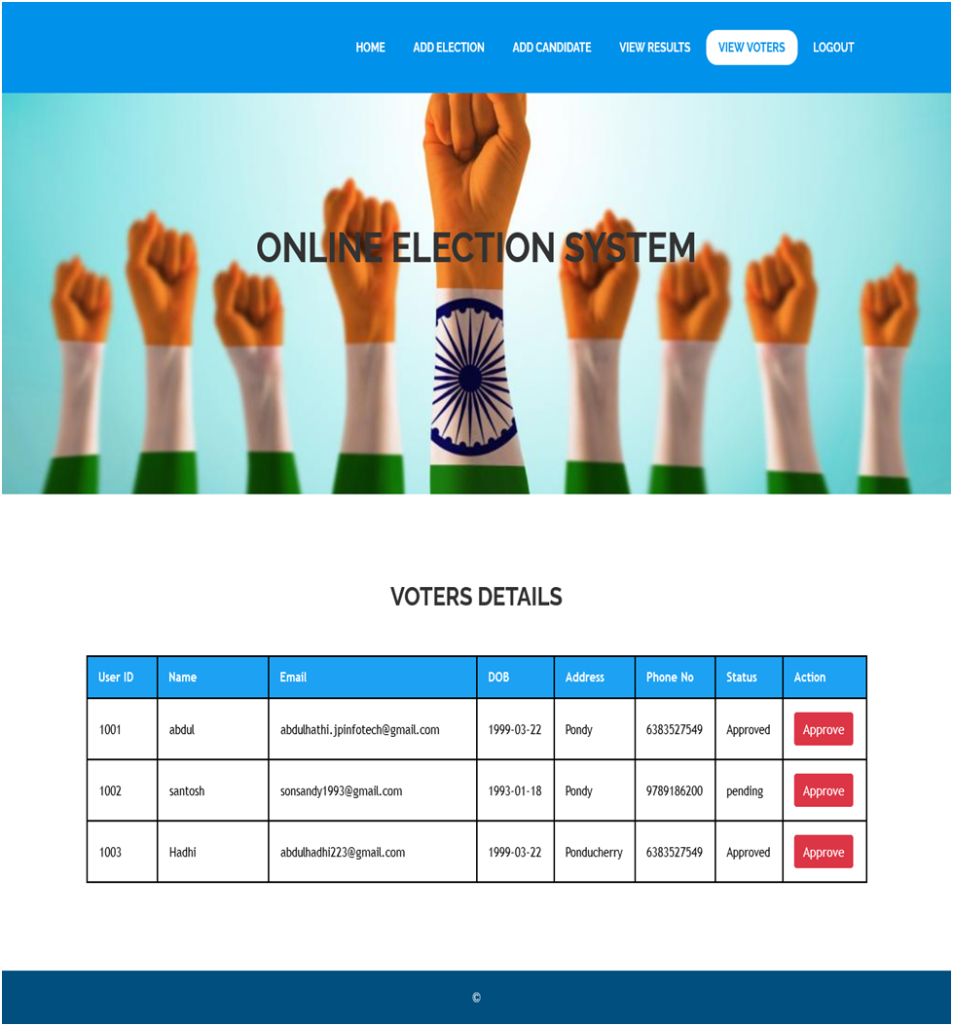
ADMIN APPROVE USER REQUEST

Slide 22
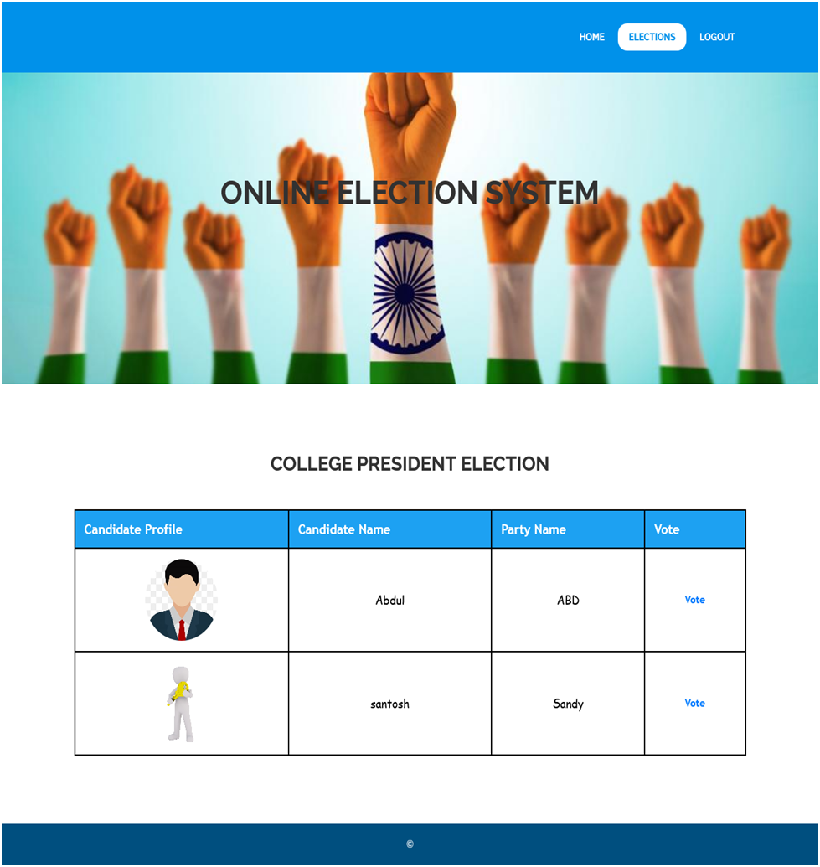
VOTER CAST VOTE

Slide 23
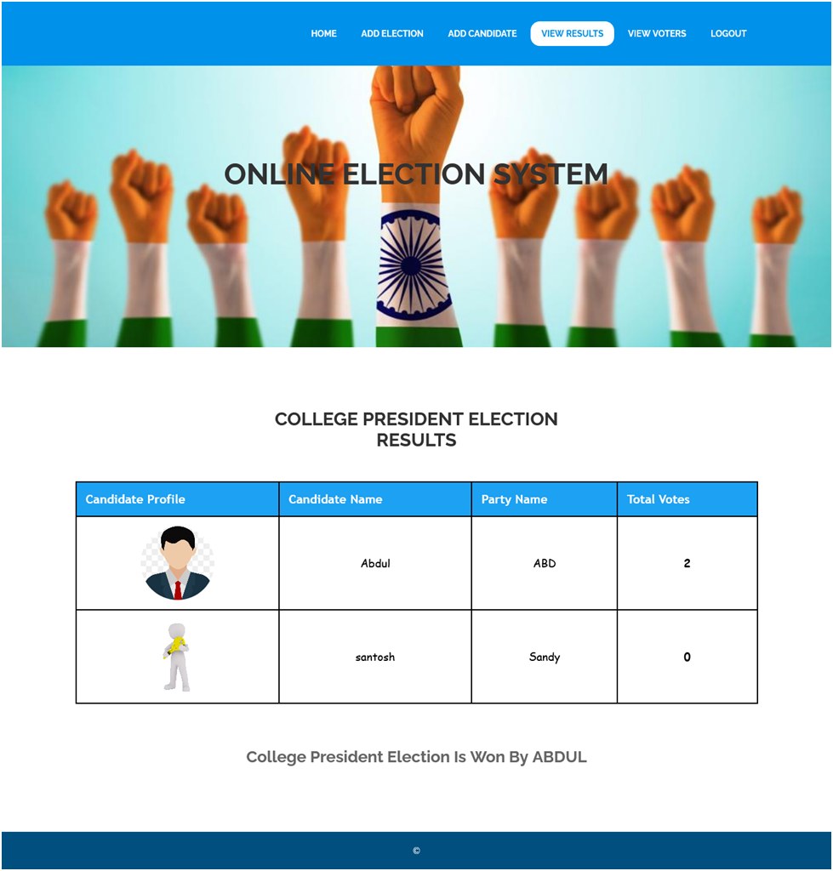
ADMIN CAN VIEW RESULTS

Slide 24
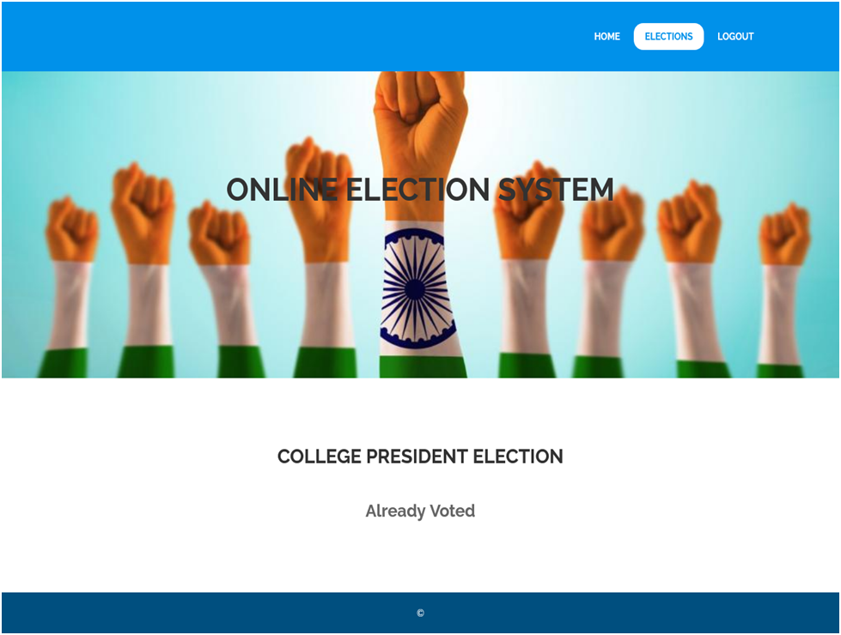
USER AFTER CASTING VOTE

Slide 25
Test cases
Test Case No: | Functionality to be Checked | Actual Input | Actual Output | Expected Output | Status
1. | Verify admin login | Give valid id and Invalid id password | Login Successful | Deny Login | Fail
 |  | Give Valid id and valid password | Login Successful | User Allowed | Pass
 |  | Give invalid id and invalid password | Login Successful | Deny login | Fail
2. | Verify Voter login | Give valid id and invalid password | Login Successful | Deny login | Fail
 |  | Give valid id and password | Login Successful | User Allowed | Pass

Slide 26
CONCLUSION
Automation of the entire system improves the efficiency. It provides a friendly graphical user interface which proves to be better when compared to the existing system.Updating of information becomes so easier.The System has adequate scope for modification in future if it is necessary

Slide 27
rEFERENCE
[1]. Malwade Nikita, Patil Chetan, Chavan Suruchi, Prof. Raut S. Y, Secure Online Voting System Proposed By Biometrics And Steganography, Vol. 3, Issue 5, May 2017.
[2]. Ankit Anand, Pallavi Divya, An Efficient Online Voting System, Vol.2, Issue.4, July-Aug. 2019, pp- 2631-2634.
[3]. Alaguvel.R, Gnanavel.G, Jagadhambal.K, Biometrics Using Electronic Voting System with Embedded Security, Vol. 2, Issue. 3, March 2018.
[4]. Firas I. Hazzaa, Seifedine Kadry, Oussama Kassem Zein, Web-Based Voting System Using Fingerprint: Design and Implementation, Vol. 2, Issue.4, Dec 2019.

Slide 28

Thank you

